Slide 1
Hotel Bookings Dashboard BST Data Analyst Assessment
Maria Anthony Raja. R
M.Sc. Data Analytics – Sri Ramachandra Engineering and Technology

Slide 2
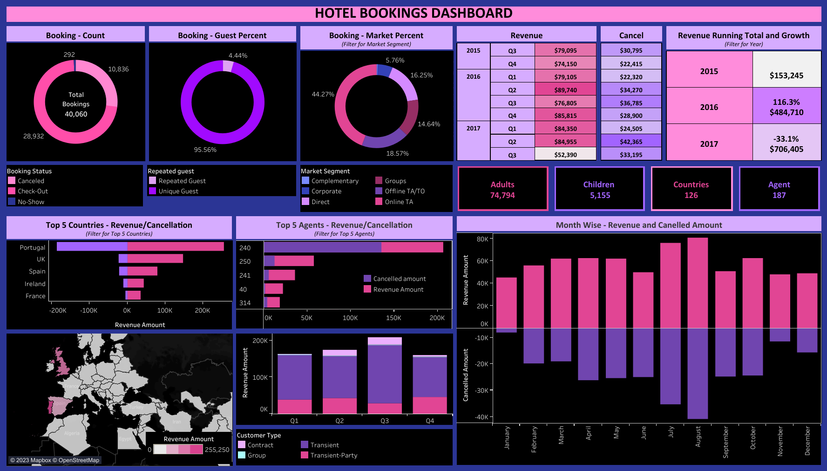

Slide 3
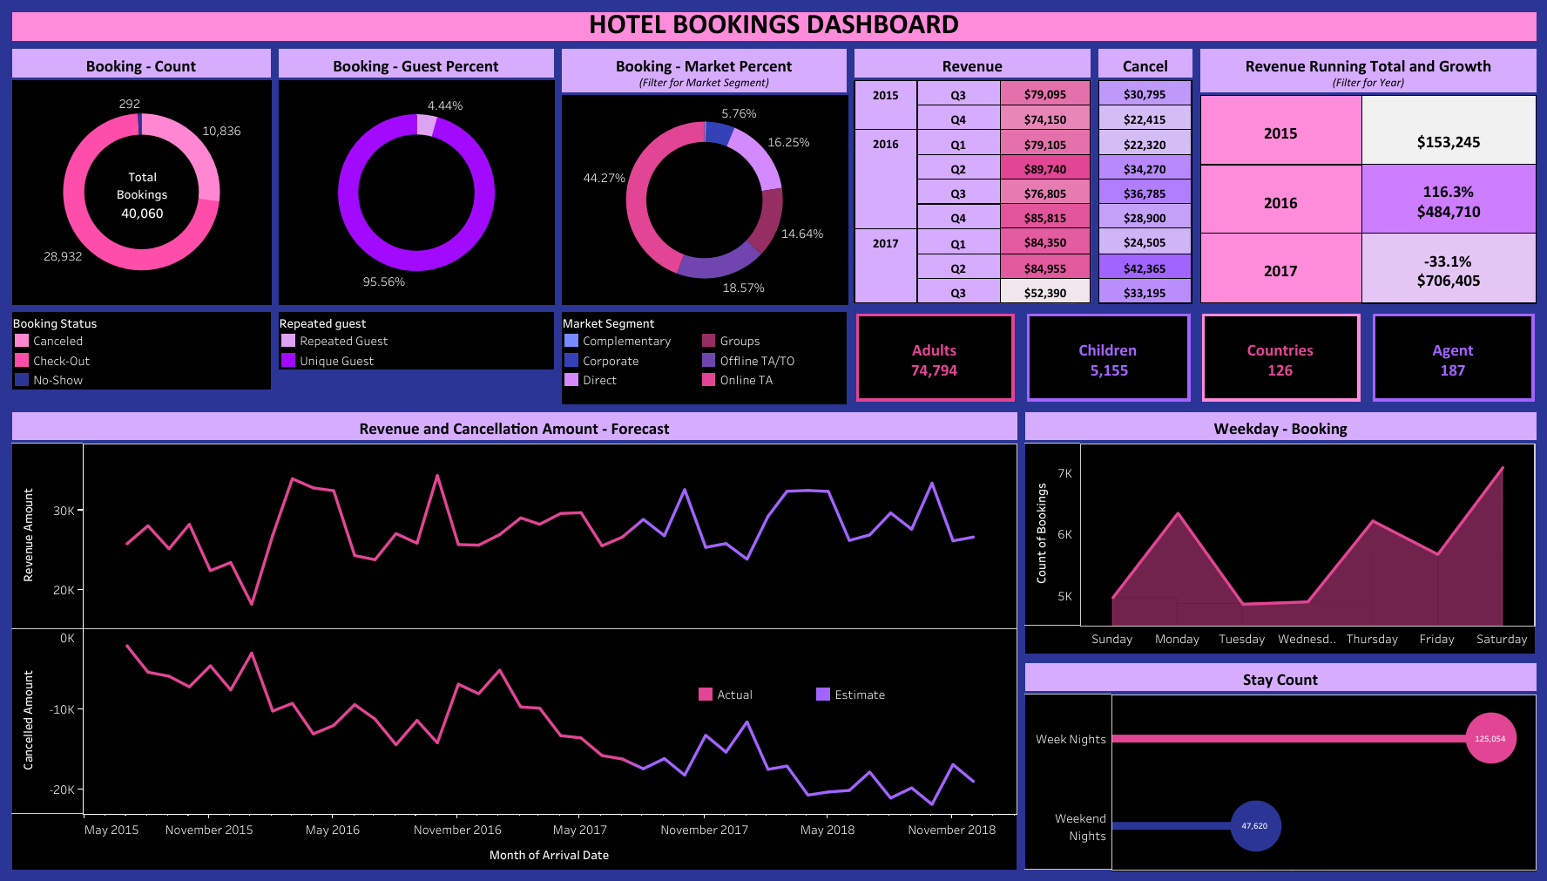

Slide 4
Results and Discussions
Though the report has many insights, let’s point out some of the key insights which can help in achieve the best performance in business.
Key insights:
Portugal has highest revenue among all countries.
Market segment: Online TA has highest bookings.
July and August (Quarter 3) have highest revenue as well as cancellation amount.
Agent: 240 have highest revenue as well as cancellation amount.
Revenue growth – 2016: 116% and Revenue growth – 2017: -33%.

Slide 5
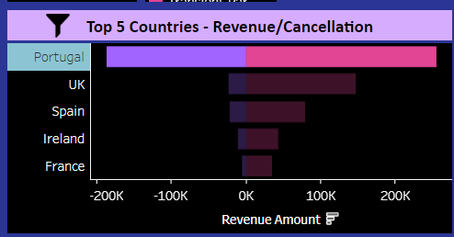
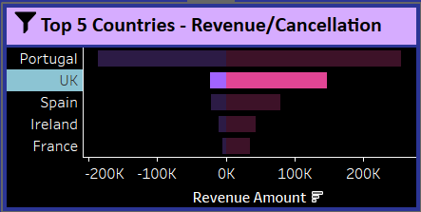
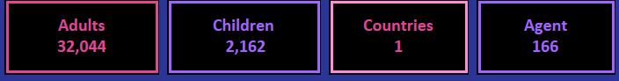
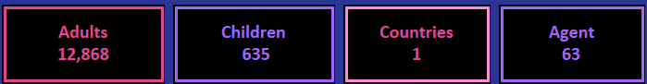
1) Portugal has highest revenue among all countries
Portugal (1st highest performing country) have 166 Agents. However, UK (2nd highest performing country) have 63 Agents only.
This clearly shows that Portugal have more agents. Hence, it reflects in high performance in revenue.

Slide 6
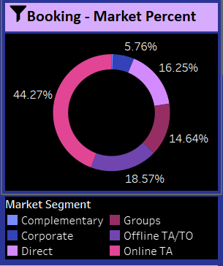
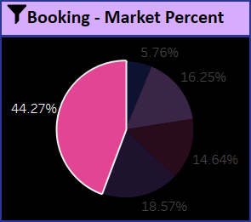
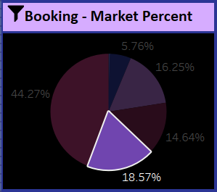


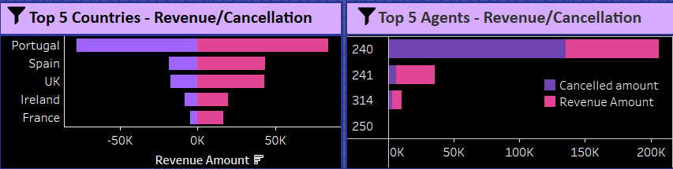
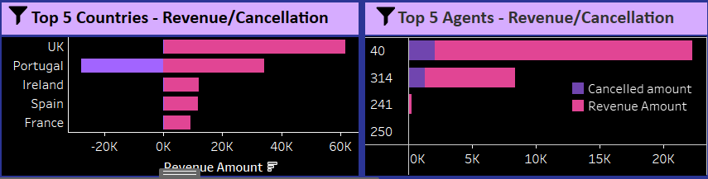
2) Market segment: Online TA has highest bookings.
Via Market Segment: Online TA, there’s 44% bookings. 115 countries and 29 Agents contributes the bookings. Portugal have received more revenue because of the more Online TA. Agent: 240 is highest contributor.
Via Market Segment: Offline TA/TO, there’s 18.5% bookings. 56 countries and 108 Agents contributes the bookings. UK has received more revenue because it has more Offline TA/TO. 240 is highest contributor.

Slide 7
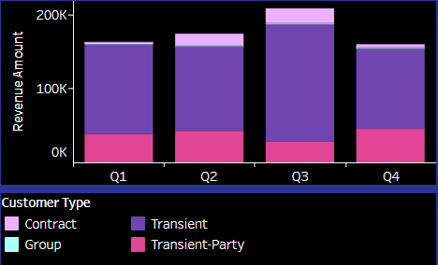
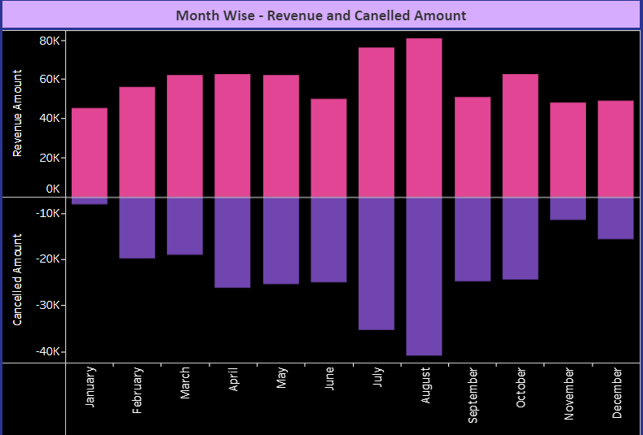
3) July and August (Quarter 3) have highest revenue as well as cancellation amount.
Quarter 3 has more Customer in type – Contract which makes Q3 a high performing quarter.
Same way Quarter 3 has more cancellation because July and August are the best performing month as well as they have highest cancellation amount. This is because July and August are the highest booking months.

Slide 8
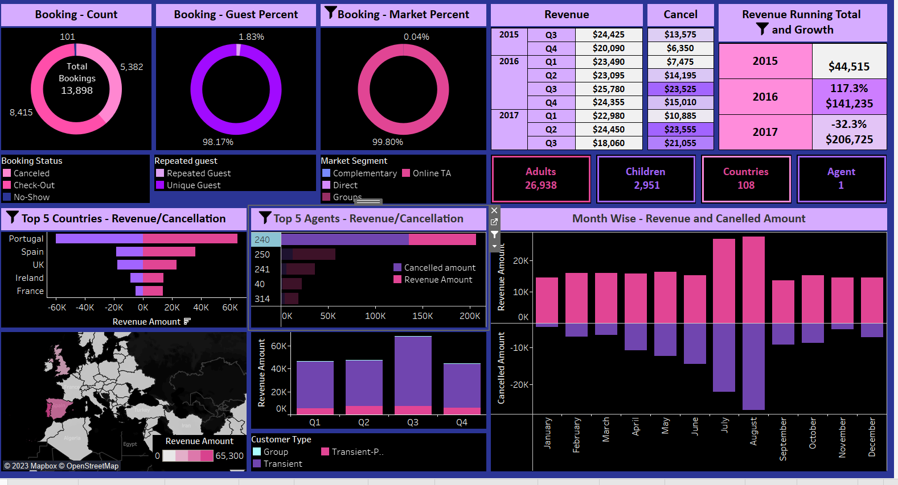
4) Agent: 240 have highest revenue as well as cancellation amount.
Agent 240 is the best performing agent.
Agent 240 influences the Online TA bookings, Q3 revenue and Portugal revenue.
Agent 240 involves in 108 countries this is the reason for the best performance.

Slide 9
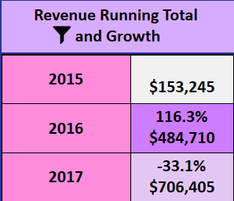
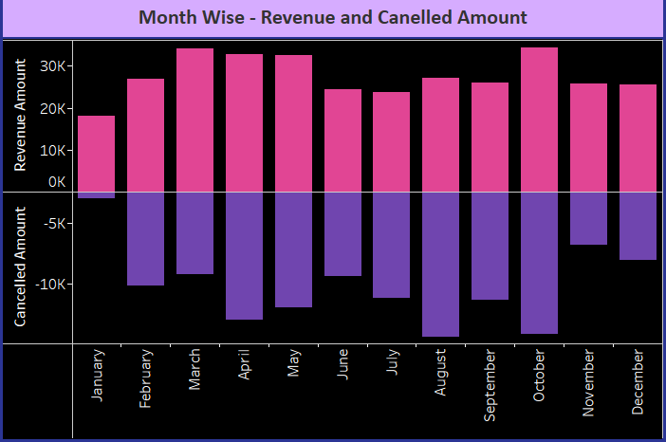
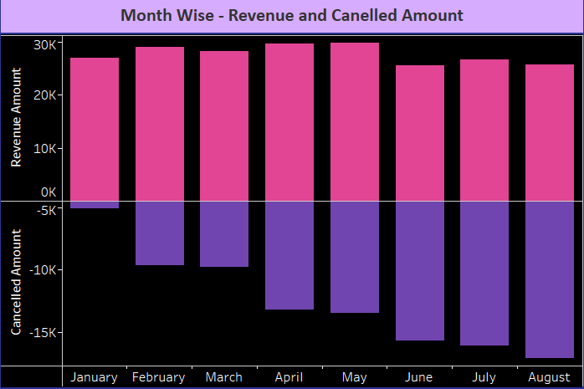
5) Revenue growth – 2016: 116% and Revenue growth – 2017: -33%.
The dataset doesn’t have data for month – Sep 2017 to Dec 2017. This effects the negative growth in 2017.

